Slide 1

HCI - Assignment n.2
Design and prototyping of an application using a human-centered approach
Deliverable n. 1: Requirement Analysis
Project Title: PCReplay
Group: Luís Diogo, 108668
Gonçalo Monteiro, 107758
João Rodrigues, 103947
Lab Class: P7
HCI 2023-2024

Slide 2
Introduction
PCReplay
Our current society is driven by constant technological innovation, which results in many electronic devices getting obsolete.
Why this project?
Favor the sell of used electronic products
Offer a secure and reliable shopping experience
Promote sustainability and reduce electronic waste
This website idea came from its somewhat absent in the current market mixed with the search of similar services, and offering users full transparency between the buyers and the sellers, as well as specialized assistants in the area.
HCI 2023-2024
‹#›

Slide 3
Interviews
PCReplay
1: 21 years old, student, knows little about computers
2: 22 years old, worker, knows something about computers but does not have the necessary knowledge to evaluate them
3: 35 years old, worker, knows little about computers
Interviewed | 1 | 2 | 3
Have you ever considered buying a used/refurbished computer? | yes | yes | yes
Seller-inspired trust (0-10) | 6 | 3 | 5
Feel well served with the used computer sales services available | no | no | yes
Would you be interested in a service that showcases all the qualities of the product to the fullest extent possible? | yes | yes | yes
Conclusions:
interested parties have already considered purchasing used computers
a considerable portion of interested parties do not have the knowledge, much less the means of evaluating the quality of computers
especially for people who are more familiar with the subject, the sellers do not inspire security
HCI 2023-2024
‹#›

Slide 4

Project Objectives
PCReplay
Create an easy method to buy/sell second hand computers.
Helping to make second-hand sales a more common practice.
Give people a transparent, enlightening and objective service that inspires confidence.
HCI 2023-2024
‹#›

Slide 5

Personas
PCReplay
John, the experienced buyer
Is 28 years old, a software developer that loves tech, single and lives in the city.
Has experience with online shopping and is always on the lookout for good deals around electronic devices, and he may invest some time searching for prices.
Wishes to have access to complete and precise information regarding these products as well as to customer support if any problems appear.
He may find himself with problems finding trustworthy and quality used products.
HCI 2023-2024
‹#›

Slide 6
Personas
PCReplay
Mary, the occupied mother
Is 35 years old, works as a consultant in a marketing company and has two small kids.
Prefers practicality and efficient in her transactions.
Wishes to sell her electronic devices in a fast and easy way, without having to bother to deal directly with the buyers.
May feel overloaded with her daily responsibilities and she may not have time to dedicate to search for prices.
HCI 2023-2024
‹#›

Slide 7
Personas
PCReplay
Thomas, the computer geek
Is 31 years old, works as a specialist and administrator for the PCReplay.
He loves computers and knows everything about them.
Likes to help others, and have everything organized.
His biggest problem is the need of a organized environment of work to comply with him.
HCI 2023-2024
‹#›

Slide 8
Scenarios
PCReplay
Scenario 1: John’s Tech Hunt
John needs a new computer suited to his needs
His work requires a flawless computer.
John finds PCReplay that guarantees the service he is looking for
Scenario 2: Mary’s New bought
Mary needs to replace her old computer with a faster one.
She needs a salesperson who inspires confidence and helps her with the purchase.
HCI 2023-2024
‹#›

Slide 9
Scenarios
PCReplay
Scenario 3: Mary’s Quick sale
She needs to sell her old computer quickly to make room for a new one. She doesn't have time to deal with the hassle of finding buyers and negotiating prices.
She wants a reliable service that allows her to sell her products with ease.
Mary can focus on her work and family responsibilities without worrying about the hassle of selling her computer.
Scenario 4: Mary’s Sale status
With her computer for sale, Mary wants to see the status of her product and communicate with an interested party.
HCI 2023-2024
‹#›

Slide 10
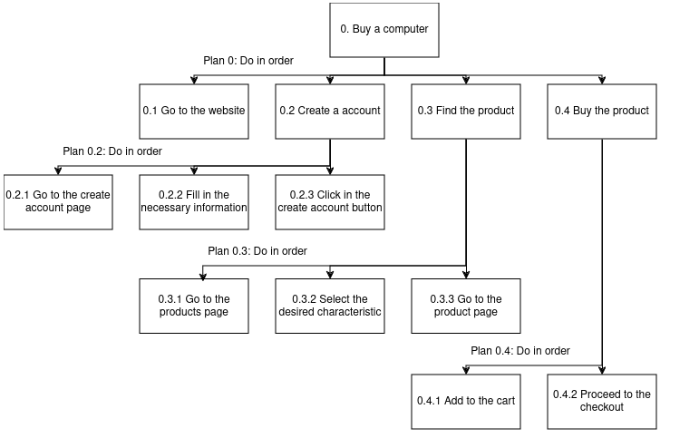
Tasks
PCReplay
Scenario 1: Create an account and buy a used computer.
The buyers has all qualitative characteristics presented in a clear and objective way.
HCI 2023-2024
‹#›

Slide 11
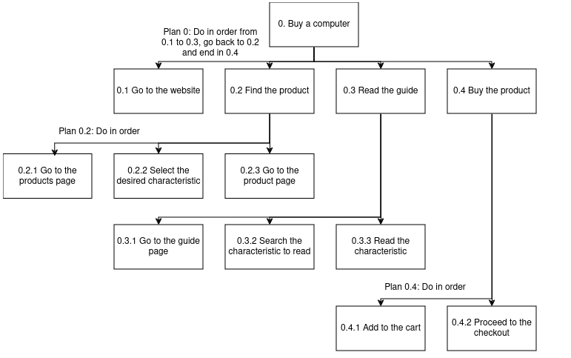
Tasks
PCReplay
Scenario 2: Learn about all characteristics imposed on the computer and buy it.
The buyer is informed to make the purchase.
HCI 2023-2024
‹#›

Slide 12
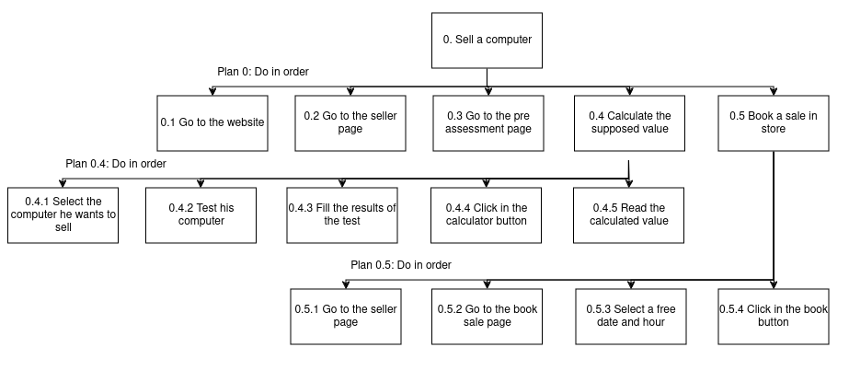
Tasks
PCReplay
Scenario 3: Calculate the value of the used computer and book a sale.
The seller will know whether it is worth selling
and will have a date for the sale.
HCI 2023-2024
‹#›

Slide 13
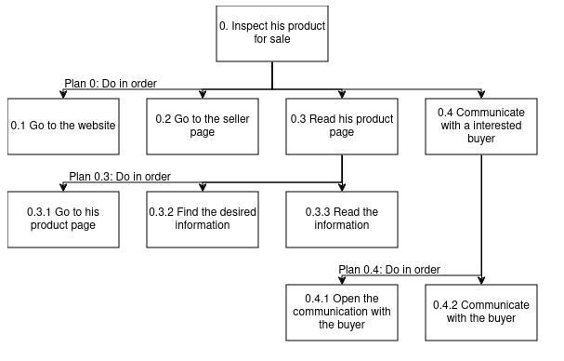
Tasks
PCReplay
Scenario 4: Inspect the computer that his selling and communicate with the interested party.
The seller will be informed about the status of his computer
HCI 2023-2024
‹#›

Slide 14

Requirements
PCReplay
Functional Requirements for users
Buyers
Search system/advanced search filter
Product display page
Product pages
WishList
Shopping cart
Secure Checkout
Rating and Comments System
Communication system with a specialist/seller: to clarify doubts/negotiate prices.
Notification system
HCI 2023-2024
‹#›

Slide 15
Requirements
PCReplay
Functional Requirements for users
Sellers
Product pre-evaluation system: to give an approximate value of the sales value
Valuation/sale/… date marking system
Page of products for sale: if you have chosen mediation, show the page visible to the buyer, number of views, number of wishlists, accept the sale, cancel the sale.
Communication system with a specialist/buyer: to clarify doubts/negotiate prices
Notification system
HCI 2023-2024
‹#›

Slide 16
Requirements
PCReplay
Functional Requirements for users
Profile/general
User Registration: to facilitate future purchases, order tracking and communication. Also have the option of becoming a seller
User Account Management: manage personal accounts, including updating personal information and order history
Features Guide: Clarify the meaning of each feature evaluated in computers
Notification system
HCI 2023-2024
‹#›

Slide 17
Requirements
PCReplay
Functional Requirements for administrators/specialists
Inventory management: to manage product inventory, including adding, editing and removing items.
Customer support management: live chat, contact forms and characteristics guide to help users with purchase-related questions and issues.
HCI 2023-2024
‹#›

Slide 18
Requirements
PCReplay
Non-functional requirements
Security and privacy
Available, reliable and responsive
Capacity: present 10 thousand products and allow scaling
Usability: intuitive to use and objective
Guarantee of product quality
HCI 2023-2024
‹#›

Slide 19

Next steps
PCReplay
Make a prototype using Figma
Make a quiz
Test it with potential users
Use the feedback to improve the design
HCI 2023-2024
‹#›

